Slide 1

Beat Invaders
TEAM BEAT 14/6/23

Slide 2




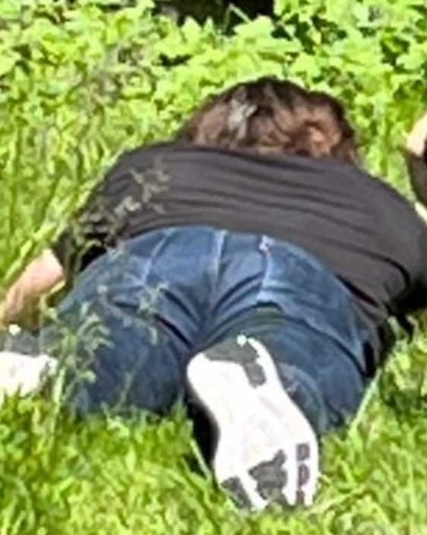
Team beat
Mano
CDO
Tim
CTO
Rover
CPB

Slide 3


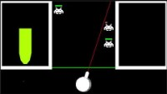
Beat Invaders
Beat Invaders
Near Infinite replayability
One-Button game

Slide 4


What we need - Crunch for The Crunch

Slide 5

Pizza purpose

Slide 6

Pizza purpose

Slide 7

Tit for Tat
Game Studies and Engineering mascot

Slide 8

Timeline
16/7/2
23/7/23
9/7/23
Pizza night two
Pizza night three
31/7/23
Itch.io Release date
Pizza night one

Slide 9

THANKS
Pizza your way to the future
Does anyone have any questions?
beat@team.com
+123456789
teambeat.com

Slide 10
CREDITS
This is where you give credit to the ones who are part of this project.
Presentation template by Slidesgo
Icons by Flaticon
Infographics by Freepik
Author introduction slide photo created by Freepik
Text & Image slide photo created by Freepik.com

